Slide 1
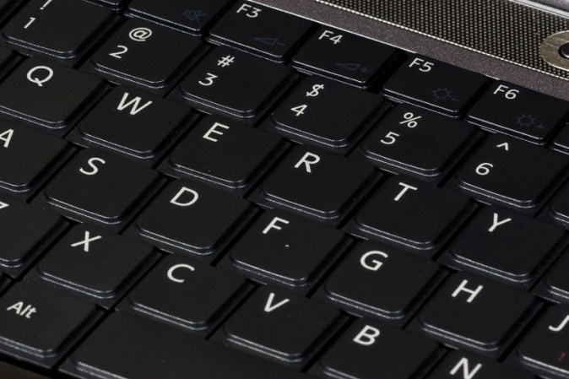
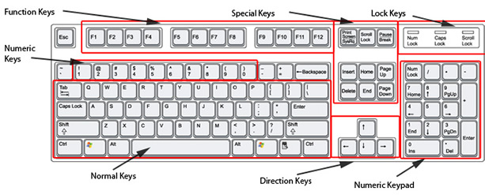
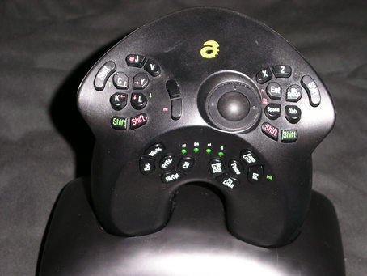
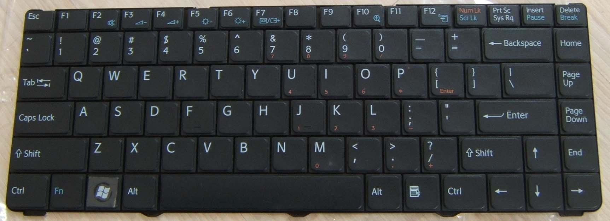
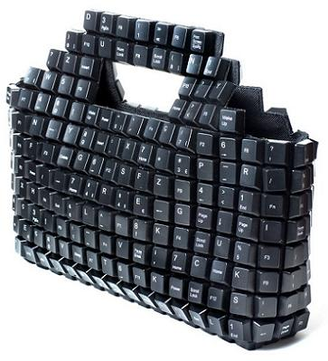
Computer Keyboard

Slide 2
In computing, a keyboard is a typewriter-style device, which uses an arrangement of buttons or keys, to act as mechanical levers or electronic switches. Following the decline of punch cards and paper tape, interaction via teleprinter-style keyboards became the main input device for computers.

Slide 3
In normal usage, the keyboard is used to type text and numbers into a word processor, text editor or other programs. In a modern computer, the interpretation of key presses is generally left to the software. A computer keyboard distinguishes each physical key from every other and reports all key presses to the controlling software. Keyboards are also used for computer gaming, either with regular keyboards or by using keyboards with special gaming features, which can expedite frequently used keystroke combinations. A keyboard is also used to give commands to the operating system of a computer, such as Windows' Control-Alt-Delete combination, which brings up a task window or shuts down the machine. A command-line interface is a type of user interface operated entirely through a keyboard, or another device performing the function of one.

Slide 4
HISTORY
While typewriters are the definitive ancestor of all key-based text entry devices, the computer keyboard as a device for electromechanical data entry and communication derives largely from the utility of two devices: teleprinters (or teletypes) and keypunches. It was through such devices that modern computer keyboards inherited their layouts.
As early as the 1870s, teleprinter-like devices were used to simultaneously type and transmit stock market text data from the keyboard across telegraph lines to stock ticker machines to be immediately copied and displayed onto ticker tape. The teleprinter, in its more contemporary form, was developed from 1903 to 1910 by American mechanical engineer Charles Krum and his son Howard, with early contributions by electrical engineer Frank Pearne. Earlier models were developed separately by individuals such as Royal Earl House and Frederick G. Creed.
Earlier, Herman Hollerith developed the first keypunch devices, which soon evolved to include keys for text and number entry akin to normal typewriters by the 1930s.
The keyboard on the teleprinter played a strong role in point-to-point and point-to-multipoint communication for most of the 20th century, while the keyboard on the keypunch device played a strong role in data entry and storage for just as long. The development of the earliest computers incorporated electric typewriter keyboards: the development of the ENIAC computer incorporated a keypunch device as both the input and paper-based output device, while the BINAC computer also made use of an electromechanically controlled typewriter for both data entry onto magnetic tape (instead of paper) and data output.
From the 1940s until the late 1960s, typewriters were the main means of data entry and output for computing, becoming integrated into what were known as computer terminals. Because of the limitations of terminals based upon printed text in comparison to the growth in data storage, processing and transmission, a general move toward video-based computer terminals was affected by the 1970s, starting with the Datapoint 3300 in 1967.
The keyboard remained the primary, most integrated computer peripheral well into the era of personal computing until the introduction of the mouse as a consumer device in 1984. By this time, text-only user interfaces with sparse graphics gave way to comparatively graphics-rich icons on screen. However, keyboards remain central to human-computer interaction to the present, even as mobile personal computing devices such as smartphones and tablets adapt the keyboard as an optional virtual, touchscreen-based means of data entry.

Slide 5
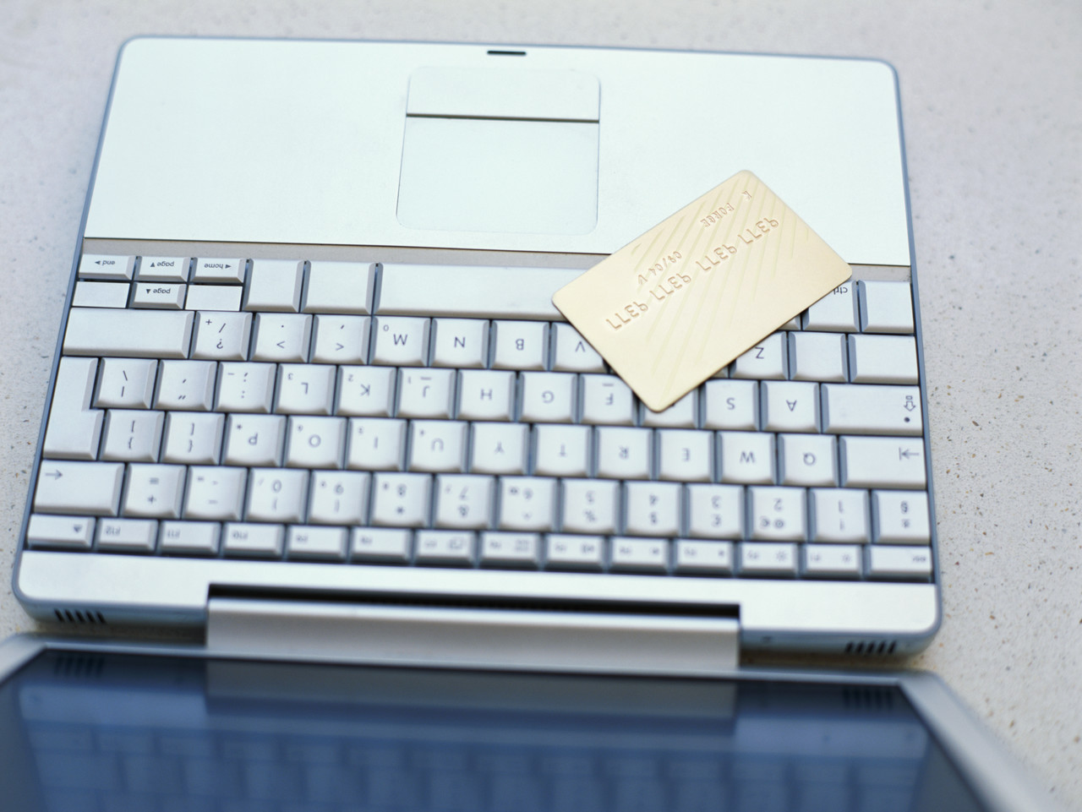
KEYBOARD TYPES
STANDARD
LAPTOP-SIZE
Handheld
Thumb-sized

Slide 6
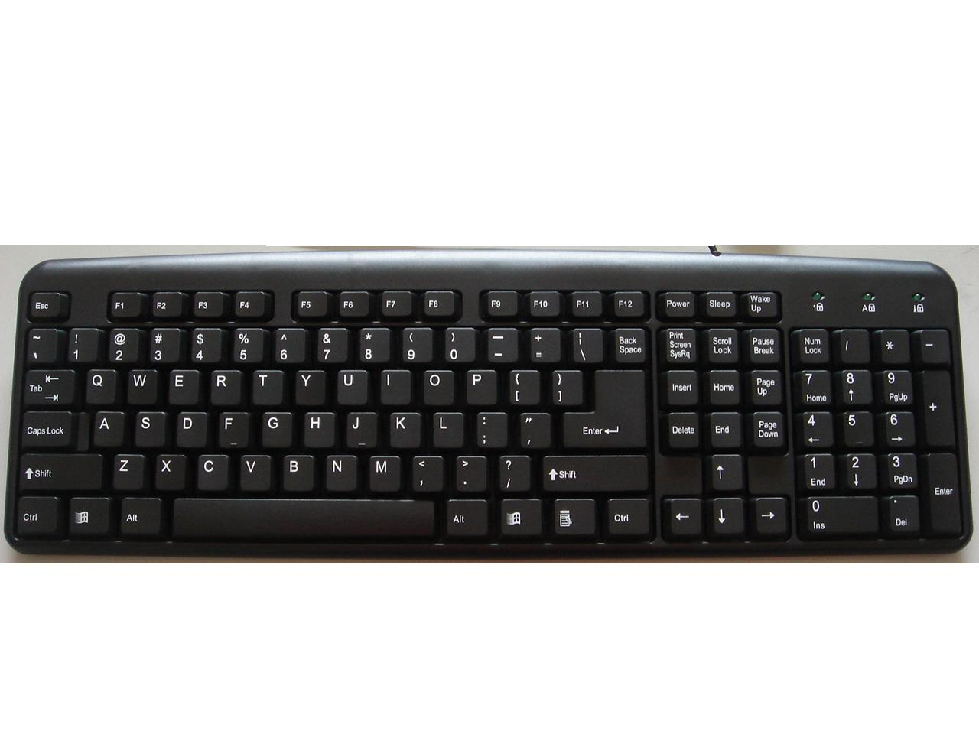
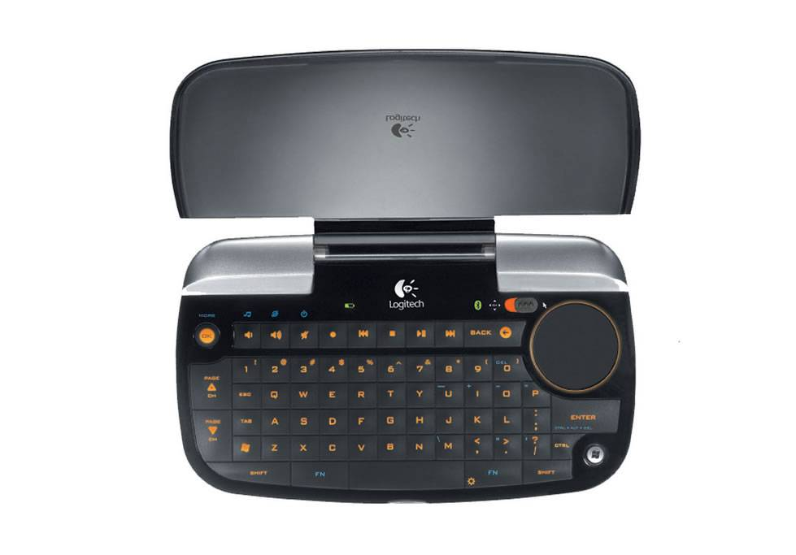
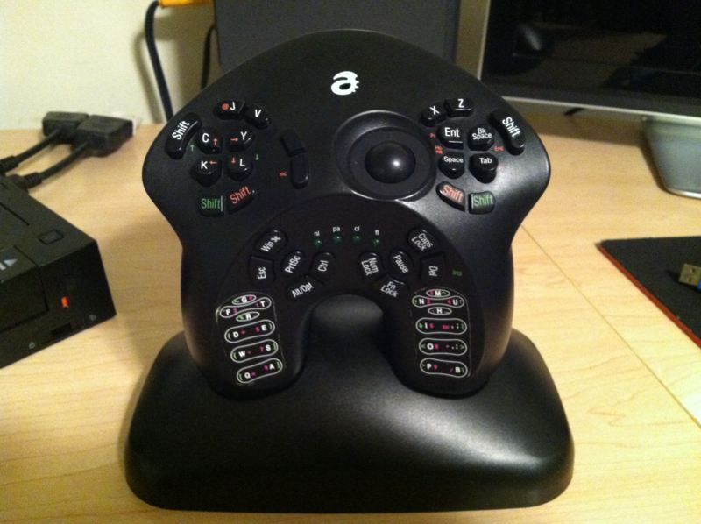
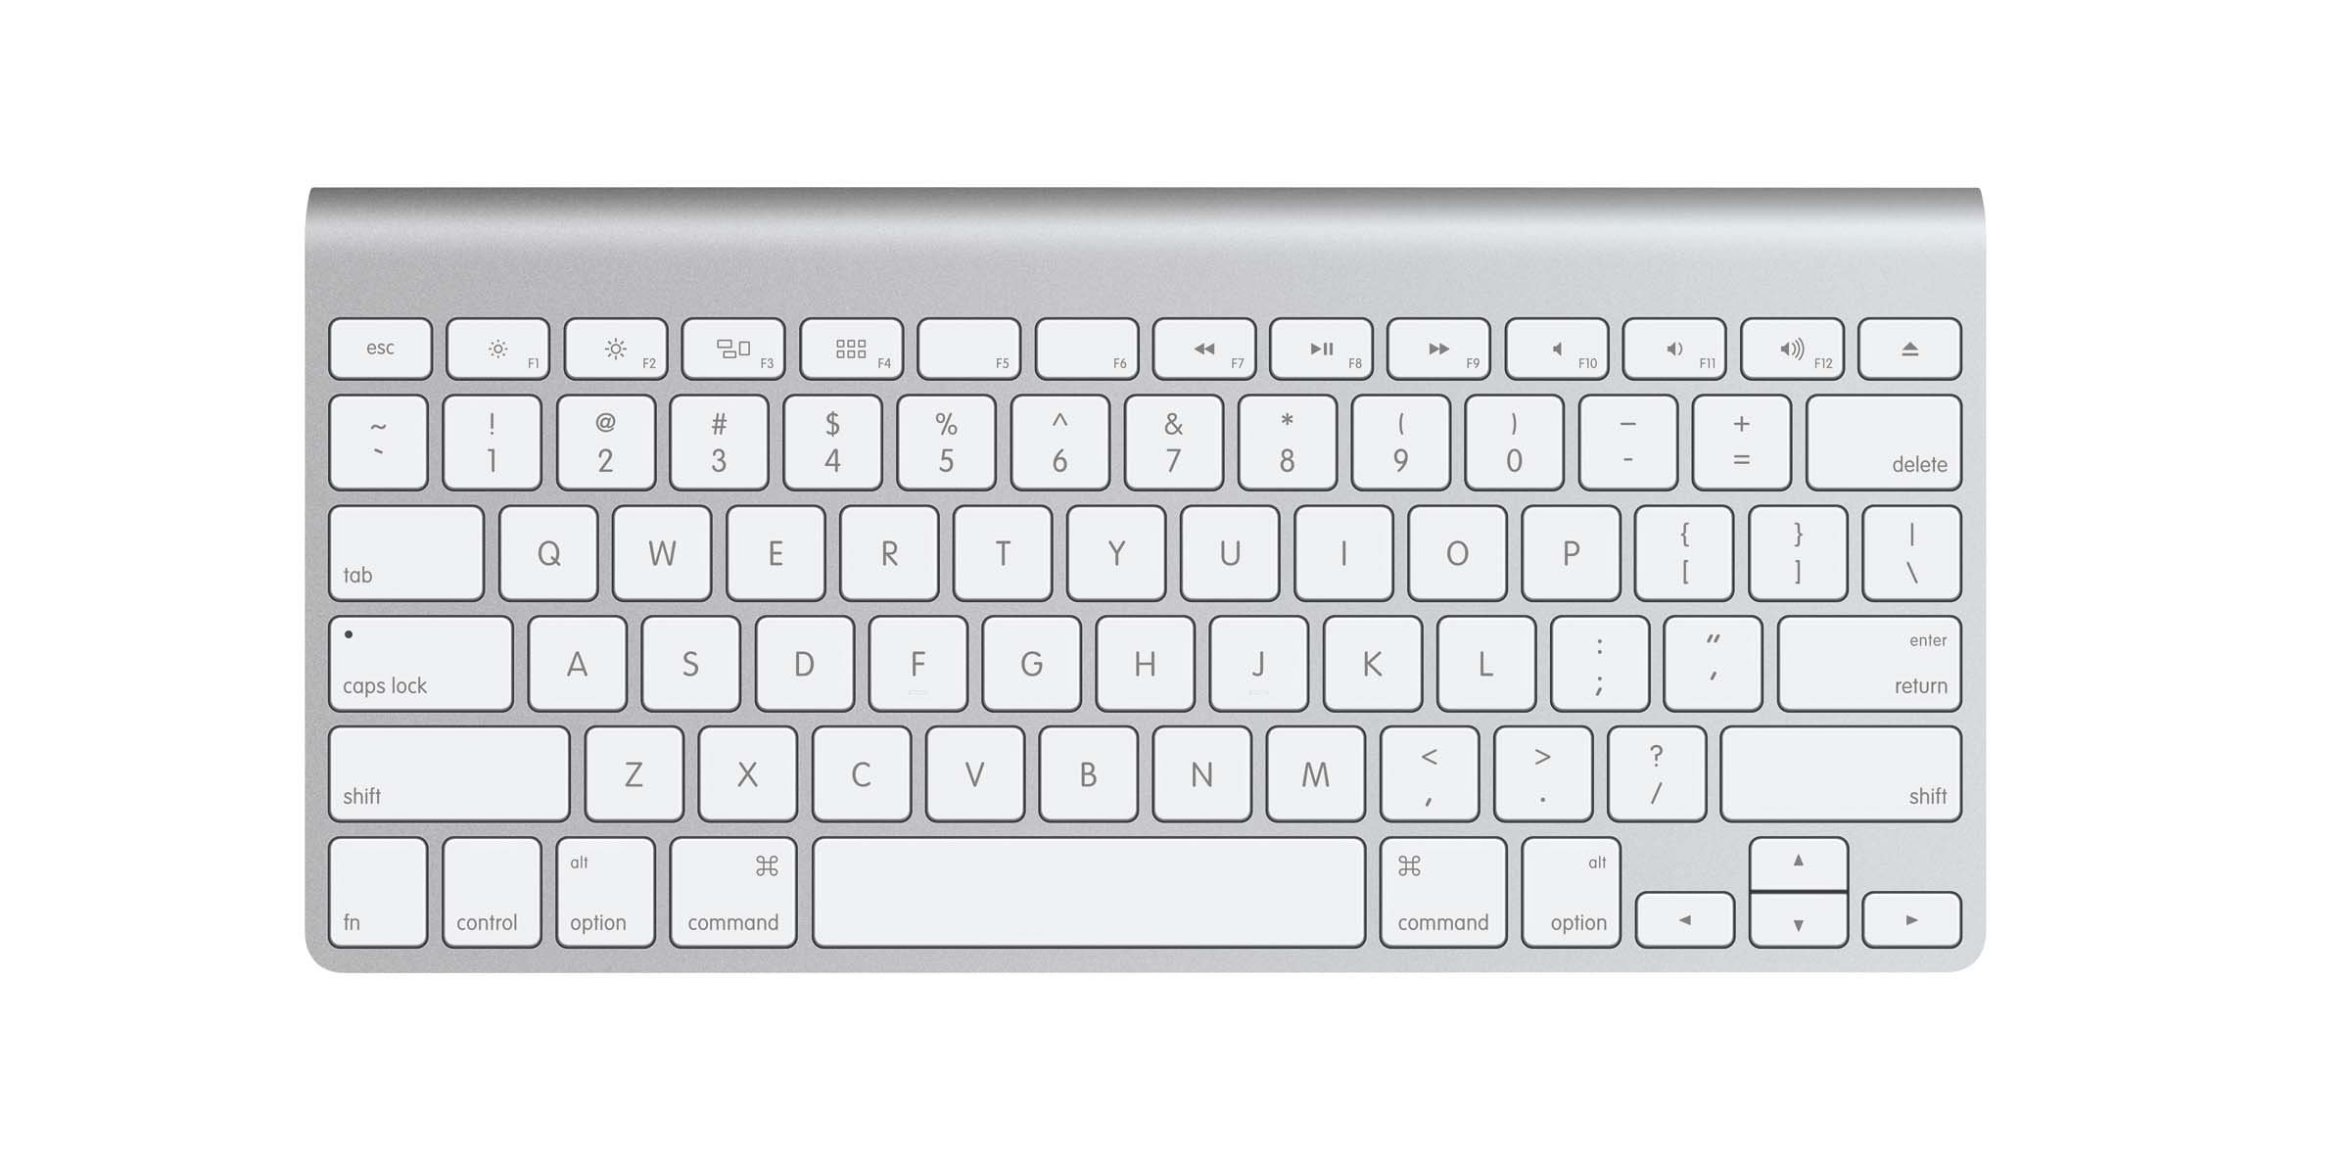
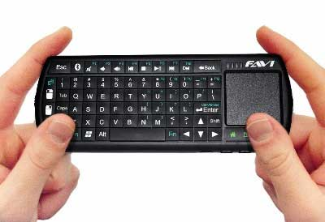
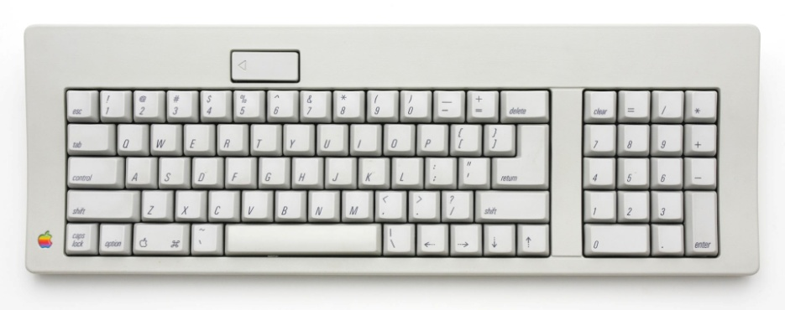
KEYBOARD TYPES

Slide 7
STANDARD KEYBOARD
Standard "full-travel" alphanumeric keyboards have keys that are on three-quarter inch centers (0.750 inches, 19.05 mm), and have a key travel of at least 0.150 inches (3.81 mm). Desktop computer keyboards, such as the 101-key US traditional keyboards or the 104-key Windows keyboards, include alphabetic characters, punctuation symbols, numbers and a variety of function keys. The internationally common 102/105 key keyboards have a smaller left shift key and an additional key with some more symbols between that and the letter to its right (usually Z or Y). Also the enter key is usually shaped differently. Computer keyboards are similar to electric-typewriter keyboards but contain additional keys.

Slide 8
Laptop size
Keyboards on laptops and notebook computers usually have a shorter travel distance for the keystroke and a reduced set of keys. They may not have a numerical keypad, and the function keys may be placed in locations that differ from their placement on a standard, full-sized keyboard.

Slide 9
HANDHELD
Handheld ergonomic keyboards are designed to be held like a game controller, and can be used as such, instead of laid out flat on top of a table surface. Typically handheld keyboards hold all the alphanumeric keys and symbols that a standard keyboard would have, yet only be accessed by pressing two sets of keys at once; one acting as a function key similar to a 'Shift' key that would allow for capital letters on a standard keyboard. Handheld keyboards allow the user the ability to move around a room or to lean back on a chair while also being able to type in front or away from the computer. Some variations of handheld ergonomic keyboards also include a trackball mouse that allow mouse movement and typing included in one handheld device.

Slide 10
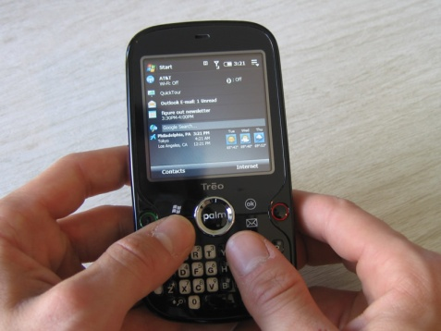
Thumb-sized
Smaller external keyboards have been introduced for devices without a built-in keyboard, such as PDAs, and smartphones. Small keyboards are also useful where there is a limited workspace.
A chorded keyboard allows users to press several keys simultaneously. For example, the GKOS keyboard has been designed for small wireless devices. Other two-handed alternatives more akin to a game controller, such as the AlphaGrip, are also used to input data and text.
A thumb keyboard (thumbboard) is used in some personal digital assistants such as the Palm Treo and BlackBerry and some Ultra-Mobile PCs such as the OQO.
Numeric keyboards contain only numbers, mathematical symbols for addition, subtraction, multiplication, and division, a decimal point, and several function keys. They are often used to facilitate data entry with smaller keyboards that do not have a numeric keypad, commonly those of laptop computers. These keys are collectively known as a numeric pad, numeric keys, or a numeric keypad, and it can consist of the following types of keys:

Slide 11
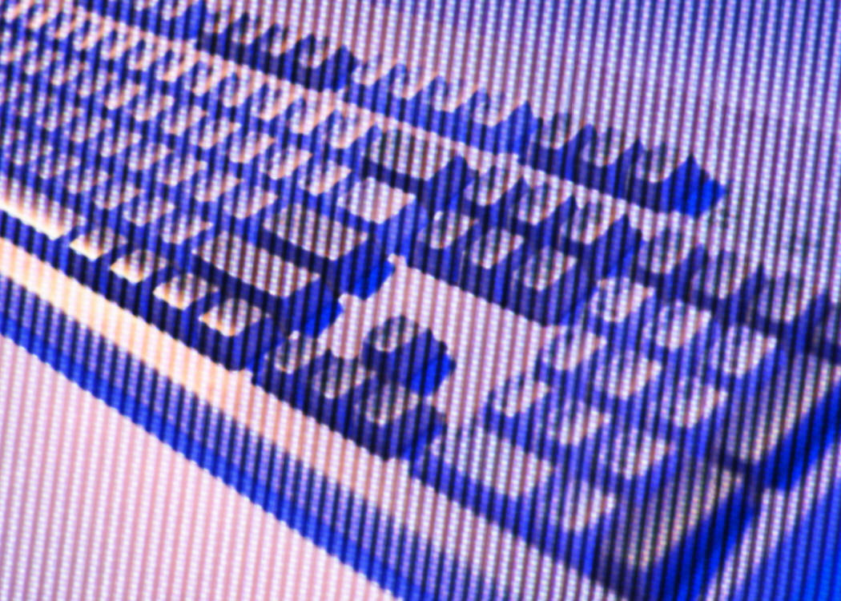
Thumb-sized
arithmetic operators such as +, -, *, /
numeric digits 0–9
cursor arrow keys
navigation keys such as Home, End, PgUp, PgDown, etc.
Num Lock button, used to enable or disable the numeric pad
enter key

